Slide 1
Sprint 4 Presentation
By: Brian Mohabeer, Anthony Espanol, and Dylan Welsh

Slide 2
Roles of Team Members
Brian Mohabeer - Team manager
Project direction, gantt chart, some work in SDD
Anthony Español - Coder
Algorithm, flowchart, developed code
Dylan Welsh - Tester
Most work in SDD

Slide 3
Challenges
Coding the robot
Aiming the robot
Floor path
Robot inconsistency
Communication between members

Slide 4
Things We Should Have Done Differently
More time for testing
Use phone to aim robot
Better communication

Slide 5
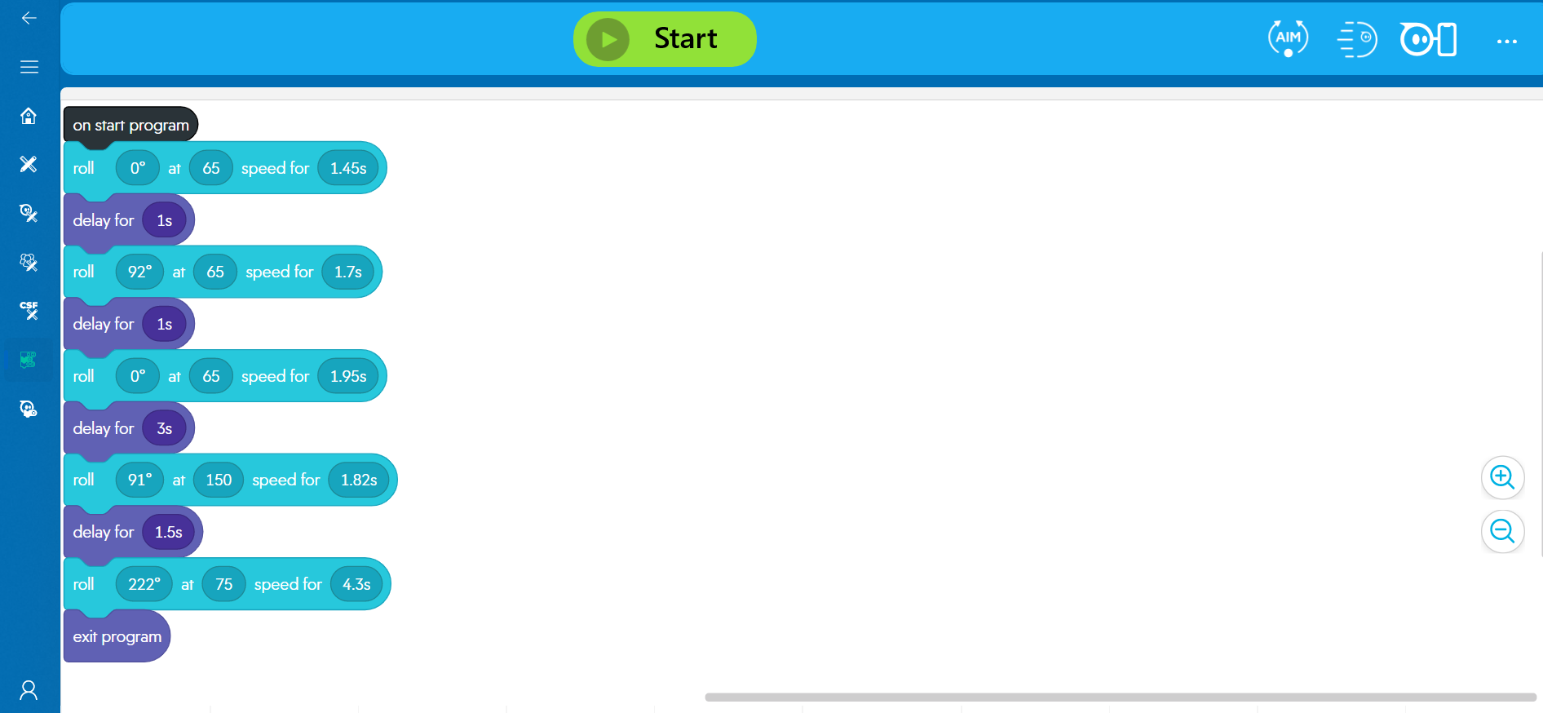
Block Code for Sprint 3 Agility

Slide 6

Video of Sprint 3 Agility

Slide 7
What We Learned About Software Engineering
Trial and error
Reiterative process
Functionality before efficiency
Coordination

